Slide 1

substance in Cyprus

Slide 2
WHY CYPRUS?
The perfect climate
All the benefits of an EU member state
Tax Benefits
A high standard of living
Amazing facilities
A low crime rate
Vasiliki Malta
Notes:
Cyprus is the third largest island in the Mediterranean Sea. Cyprus is a modern country that enjoys a strategic geographical location.
With over 320 days of sunshine each year, Cyprus is the obvious choice for sun lovers!
With double tax treaties with more than 60 countries and corporation tax set at 12.5% , its easy to save money if you live in Cyprus.
The cost of living is relatively lower than most EU countries.
Cyprus has also amazing facilities, such as great education system, National health system, transportation, 2 international airports.
A low crime rate, one of the lowest crime rates in EUROPE.

Slide 3
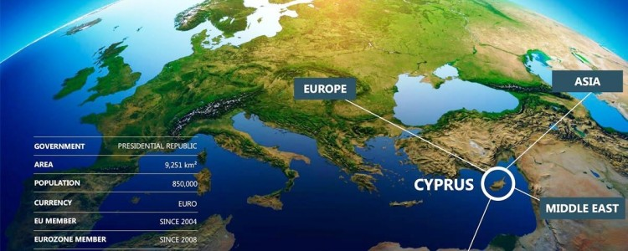
Perfectly placed
Notes:
Geographically, Cyprus is perfectly placed between three continents –Europe, Africa and Asia, being a member of the EU, as a Cyprus citizen your business can benefit from all the EU advantages.

Slide 4
Chapter 1
Taxes
All companies that are tax residents of Cyprus are taxed on their income accrued or derived from all sources in Cyprus and abroad.
Corporate tax standard rate is 12.5% payable on profits.
Capital gains from disposals of shares, bonds, debentures – are exempt (Except for disposal of real estate in Cyprus or shares of a company holding real estate in Cyprus to the extent that gains are attributable to the real estate holding).
Shipping companies – tonnage tax.
Notes:
A company is tax resident in Cyprus, it is controlled and managed from Cyprus.
A non- Cyprus tax resident company is taxed on income accrued or derived from a business activity that is carried out through a permanent establishment in Cyprus and on certain other income arising from sources in Cyprus.
Corporate tax standard rate is 12.5 %, one of the lowest in the EU. Payable on profits not income.
Capital Gains from disposals of shares, bonds, debentures and other titles of companies or other legal persons incorporated in Cyprus or abroad and options thereon are exempt.
Shipping companies they have the option to be taxed based on their tonnage instead of their income.

Slide 5
Dividends
When paid by company to a company – all taxes are exempt
When paid by company to a domiciled individual – 17%
When paid by a company to a non – domiciled individual – 0 %
Notes:
DOMICILED EXPAINED: An individual who lives in more than “183 days” in a year is eligible to become Cyprus Tax resident and benefit from all the Personal Tax Advantages in Cyprus.
A Cyprus Tax resident is taxed on his local and international income under the Cyprus tax regime.
The individual has then the opportunity to be taxed on his international income and avoid double taxation.
The total tax is paid by the Company.
This tax is called special contribution tax.

Slide 6
Taxes
Personal Tax: All Cyprus tax residents are taxed on all income accrued or derived from all sources in Cyprus and abroad.
PERSONAL TAX RATES: The following income tax rates apply to individuals:
TAXABLE INCOME (€) | TAX RATE (%) | TAX (€) | CUMULATIVE TAX (€)
0-19,500 | 0 | 0 | 0
19,501-28,000 | 20 | 1,700 | 1,700
28,001-36,300 | 25 | 2,075 | 3,775
36,301-60,000 | 30 | 7,110 | 10,885
60,001 and over | 35
Notes:
1) Individuals who are not tax residents of Cyprus are taxed on income accrued or derived from sources in Cyprus. An individual is tax resident in Cyprus if he spends more than 183 days in any one calendar year in Cyprus.

Slide 7
Cyprus Double Tax Treaties:
Andorra | Armenia | Austria | Uzbekistan | Serbia
Azerbaijan | Barbados | Belarus | USA | Seychelles
Belgium | Bosnia | Bulgaria | Ukraine | Singapore
Canada | China | Czech Republic | United Arab Emirates | Saudi Arabia
Denmark | Egypt | Estonia | United Kingdom | San Marino
Ethiopia | Finland | France | The States of Guernsey | Russia
Georgia | Germany | Greece | Thailand | Portugal
Hungary | Iceland | India | Syria | Qatar
Iran | Ireland | Italy | Spain | Romania
Jersey | Kazakhstan | Kingdom of Bahrain | Sweden
Kuwait | Kyrgyzstan | Latvia | Swiss Confederation
Lebanon | Lithuania | Luxembourg | Slovakia
Malta | Mauritius | Moldova | Slovenia
Montenegro | Norway | Poland | South Africa

Slide 8

Value Added Tax (VAT)
VAT is imposed on the supply of goods and services in Cyprus.
The standard rate is 19% and applies to the supplies of all goods and services in Cyprus which are not subject to the zero rate.
Notes:
Supply of goods and services on the acquisition of goods from other Member State and on the importation of goods from third countries.
Cyprus constitutes an attractive EU VAT jurisdiction applying several options permissible by the EU Directive among others a flexible VAT Group.

Slide 9
Chapter 2
Procedure to register a Cyprus Company
Name check/search application at the Companies Registrar (CR).
Signing of the Memorandum and Articles of the Cypriot Company- in order to act and to conduct business, a Cypriot company must be registered with the CR.
Once the procedure of the Cypriot company formation has been finalised, an application has to be submitted to the CR , applying for Cypriot company registration.
Registration may take one week from the date of submission of the application.
The costs for the registration of a Cyprus company is approx.. €1.700.
Notes:
The registration of a Cyprus Company is easy and straight forward procedure.
Submit a name check/search application, for reserving a name – formal approval to use the name is required from the Companies Registry before the name can be used.
Formation of a Cyprus Company mainly comprises the drafting of the Cypriot company’s Memorandum and Articles of Association, the appointment of directors and company secretary.
The name check application can be done online through the official website of the Companies Registry.
However, the signing of the M & A of Association of the company does not render the company operative yet, unlike in some other countries, where a company formed may act and conduct business with the status ‘ under incorporation’.
Depending on the workload at the Cyprus Registrar of Companies, Cyprus company registration may take one week from the date of submission of the application for Cypriot company registration.

Slide 10
Chapter 3
Cost of operating an office in Cyprus
The cheapest place to operate an office in Cyprus is Paphos:
Rental rates is approx. €500 per month;
Connection of electricity €250;
Connection of water €250;
Electricity is approx. €100 per month;
Water is approx. €20 per 3 months;
Refuse disposal €160 per year;
Communal expenses €20 per month.
Notes:
The utility bills are largely depend on consumption.
It is worth notable that operating an office in Limassol or in Nicosia the costs are double or even triple sometimes as regards to the rent.

Slide 11
Approximate costs for telephone set up and maintenance fees:
A one – off payment of €270 plus maintenance fees of approx. €10 per month in addition to the costs of phone calls themselves.
Approximate costs for email/Internet setup:
€200 plus VAT to set up Office365
Email hosting; an annual fee of €75 plus VAT
Website hosting: an annual fee of €20 plus VAT
Maintenance charges for Office365: approx. €3 per month.

Slide 12

Salaries
The minimum salary in Cyprus is €870 per month
Part – time employee can be employed with a salary at the range of €500 to €550 per month

Slide 13
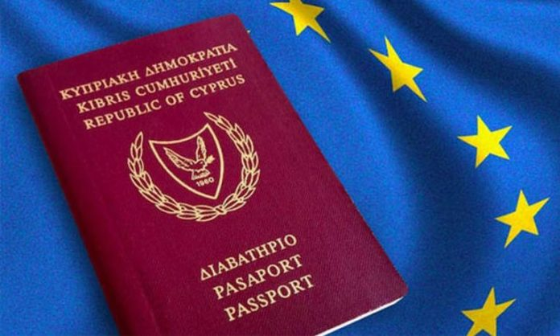
Chapter 4
Cyprus Investment Program
What is the Cyprus Investment Program?
Cyprus Investment Programme grants Cyprus Citizenship by investment to successful applicants and their families in 6 months. Individuals seeking for a second passport have to invest €2.5 million in Cyprus economy and meet some additional criteria.

Slide 14
Changes to the Investment Program
The potential investor should already be a holder of a Schengen Visa before being able to apply for investment, and Government Bonds are no longer included in the list of qualifying investments.
Overall the CIP, as it now stands, includes citizenship by investment, through new aspects that cannot be waived, such as a €75,000 donation to the Cyprus Land Development Association.
Notes:
In February 2019, the Cyprus Government has announced new changes to the CIP in order, as it describes, to reduce the risk of abuse.

Slide 15
Other changes to the Program include:
The inclusion of the shipping sector in the list of eligible investments for the CIP
Investment in housing units (including a private permanent residence) has now been increased to €2.5 million from the previous €2 million).
Potential candidates can now invest in Cyprus Register Alternative Investment Funds(AIFs), as well as up to €200,000 in the Cyprus Stock Exchange’s secondary market.
Notes:
1) The inclusion of the shipping sector in the list of eligible investments for the CIP, which should adhere to certain criteria determined by the Ministry of Finance and the Deputy Ministry for Shipping.
2) Investment in housing units (including a private permanent residence) has now been increased to €2.5 million from the previous €2 million).
3) Potential candidates can now invest in Cyprus Register Alternative investment Funds(AIFs), as well as up to €200,000 in the Cyprus Stock Exchange’s secondary market.
If the applicant’s three total investments, including a private residence valued at €2.5 million, and residential unties already used for the purposes of the CIP which will be reused under the same Program, following the stipulation that if the applicant has made investments in a residential unit(s) on the basis of the ‘Investment in Immovable property, Land Development and Infrastructure Projects’ criterion, there is no requirement for the purchase of another private residence in Cyprus.
If the applicant’s three total investments, including a private residence valued at €2.5 million, and residential units already used for the purposes of the CIP which will be reused under the same Program, following the stipulation that if the applicant has made investments in a residential unit (s) on the basis of the ‘Investment Immovable Property, Land Development and Infrastructure Projects’ criterion, there is no requirement for the purchase of another private residence in Cyprus.

Slide 16
Now the investment will need to be maintained for 5 years instead of 3.
If another EU Member State has rejected the applicant’s previous application for citizenship in that Member State, then the applicant will not be eligible to apply for Cypriot Citizenship through the CIP framework.

Slide 17
CONCLUSION

Slide 18
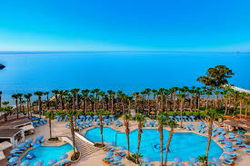

Notes:
Cyprus is a great island to live and work.
At your free time in Cyprus you can enjoy both sea and mountain, sometimes even at the same day (depending on the weather).
In Cyprus there are hundreds of hotels, restaurants, bars, cafes and night clubs to suit every taste.

Slide 19


Notes:
We have hundreds of picturesque villages that you can visit when you live in Cyprus such as Lefkara (picture above) even Leonardo da Vinci visited Lefkara in 1481.
For wine lovers we even have some great wineries, including the no.1 wine producer on the island, Zambartas Wineries, yes it is a relative.

Slide 20

THANK YOU
For Your Attention
Notes:
Any questions?

Slide 21
CONTACT DETAILS:
VASILIKI MALTA
Euro House, 1st Floor
82 Spyrou Kyprianou Street
Limassol 4042, Cyprus
TEL: +35725373734
FAX: +35725725502
EMAIL: vasiliki.m@zambartaslaw.com.cy
www.zambartaslawoffices.com

